Slide 1

Clean Desk Policy
Maintaining a Secure Workspace

Slide 2

Introduction
A clean workspace prevents theft and unauthorized access
Support staff handle sensitive information daily
Good desk habits protect company data and reduce risk

Slide 3
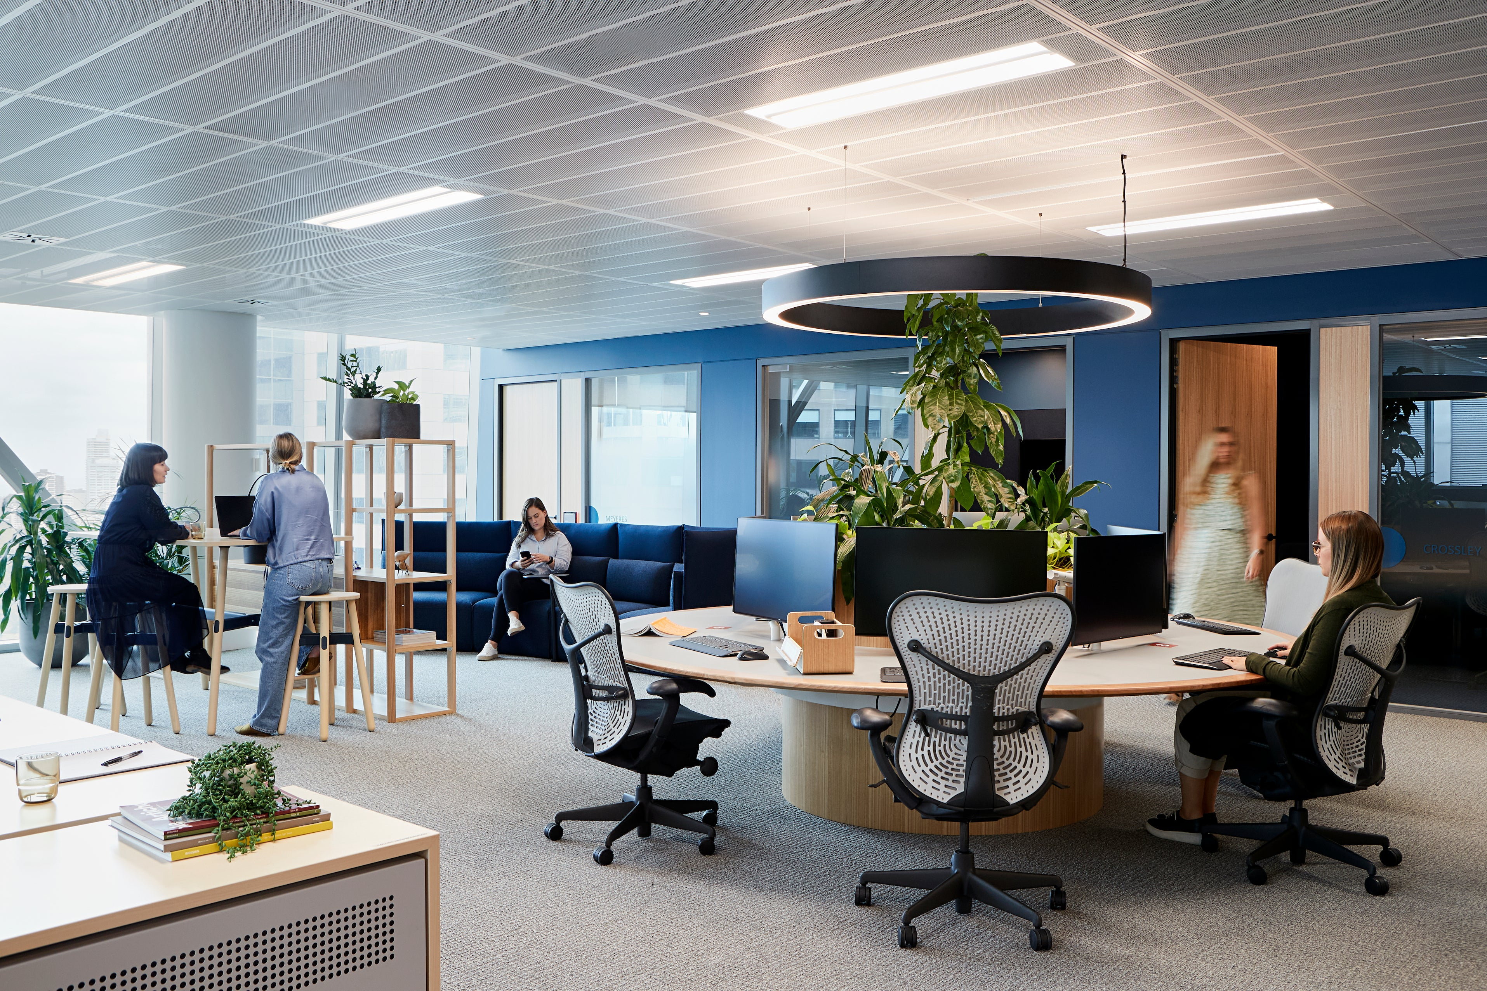
Why This Policy Matters
Keeping desks free of documents and devices reduces the chance of data exposure.
If staff leave confidential information visible or unattended, it can result in
- data breaches
- loss of equipment
- reputational damage
- or disciplinary action.

Slide 4

Policy Summary
All workspaces must remain tidy and secure
Sensitive materials must be properly stored
Workstations must be locked when unattended
Printed documents should be collected immediately

Slide 5
Secure Storage
Use locked drawers, cabinets, or safes
Never leave notebooks or documents unattended
Mobile devices must stay with you or be locked away
Computers must be locked or shut down when not in use

Slide 6
Printing and Disposal
Retrieve printed confidential documents immediately
Never place sensitive papers in normal waste bins
Use shredders or confidential disposal bins only
Clean whiteboards after meetings

Slide 7
Compliance
Regular walkthroughs and inspections
Possible spot checks
Reporting mechanisms for issues
Repeated non-compliance may lead to further action

Slide 8
Thanks For listening

